Slide 1

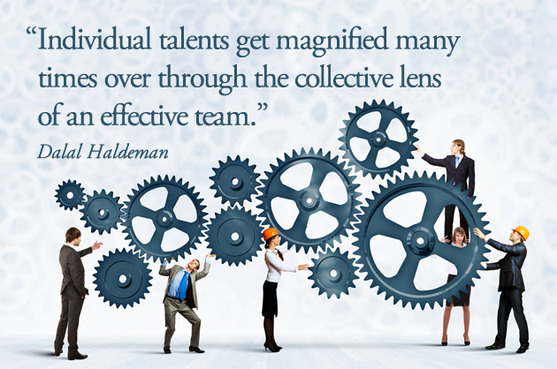
Guidelines For Conducting a Productive Meeting
The goal is to establish meeting ground rules for positive interaction that will assist in making unanimous decisions. The following are guidelines that can help to ensure that everyone feels open to contribute during meetings, decisions are made in the best interests of SDAL, and all attending are treated with respect.
Mark Almanza, Maddie Arnsbarger, Jessica Flynn, Millicent Grant, Adrienne Rogers,Will Sandholtz, Emily Stark, and Samantha Tyner, 2016 Data Science for the Public Good Student Fellows
How To Establish Meeting Rules
Ask each group member for one rule that s/he thinks is important for conducting productive meetings.
Create a list of these rules so that everyone can see the list.
Repeat step two until everyone is satisfied that the list is complete.
Review the list and make any necessary edits (note: rules can be added to the list to address any new concerns)
Finally, agree as a group to follow the rules to improve the meeting process.
The following are the meeting guidelines created by the 2016 Summer SDAL DSPG Student Fellows.
Logistics
Behavior
Meeting Preparation
Be on time
Come prepared
  Bring proper materials and work you have prepared for the meeting
  Keep an open mind
  Review agenda
  Prepare to be attentive
Assign Meeting Chair and Scribe
  Meeting Chair
    Presents
    Develops agenda
    Keeps on task
    Addresses meeting members concerns
  Scribe
    Takes notes
    Sends out notes after meeting
Content of the Meeting
Declare objective at start of the meeting
Respect the agenda
  Avoid arguments and fighting
Reach a consensus
  Expect a degree of compromise
Meeting Ending and Beyond
Leave meeting with clear sense of next steps
  Who is responsible to do what and by when (include this information in meeting notes)
  Determine next meeting date
Actions
Avoid distractions (electronic devices, etc.)
Come to meeting with open mind, ready to understand and compromise
Respect others and their opinions
Listen actively to others
Conversation Skills
Give time between thoughts to let others speak
Avoid redundancy when speaking
Avoid talking over people
  Do not interrupt other participants
Speak up when necessary
Avoid turning critiques or disagreements to attacks
Sources
Chastain, Ann. “Meeting Guidelines and Ground Rules are Basic Tools for Successful Meetings.” MSU Extension. n.p., 18 Oct. 2012. Web.
“The Key to Efficient Change.” Leading with GRIT Inspiring Action and Accountability with Generosity, Respect, Integrity, and Truth (2015): 113-30. Department of Developmental Services. Web.

